Slide 1

Intro to SVG Part 4: More Basic Shapes

Slide 2

Rob Larsen
Rob is an experienced front-end engineer, author and open-source contributor.
Rob is co-author of Professional jQuery, the author of Beginning HTML and CSS, the author of The Uncertain Web, from O’Reilly, the author of Mastering SVG and co-author of The HTML and CSS Workshop.
A long-time open-source contributor, Rob currently maintains HTML5-Boilerplate and administers the H5BP organization on GitHub.

Slide 3
What we’ll cover
In this presentation we’ll learn about the following SVG elements:
Line
Ellipse
Polygon
Polyline

Slide 4
The <line> element
Notes:
As we learned in the last video, the path element allows you to draw anything you can imagine using a long series of complicated
instructions. Thankfully, there are several very convenient elements that define common shapes
that are easier to work with than the path element.
The first of these that you'll learn about is the line element. The <line> element is an SVG element used to draw a single, straight line connecting two specified points.

Slide 5
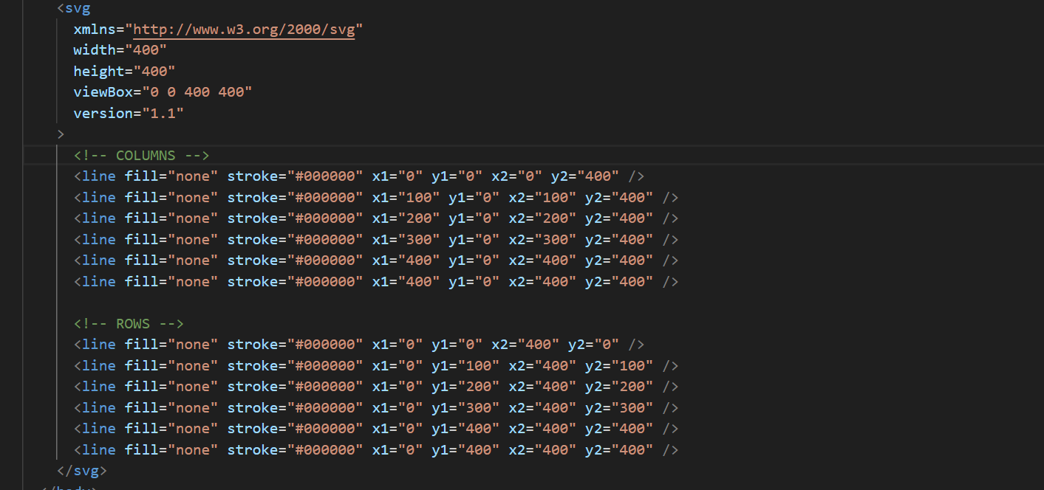
Line.html
Notes:
The following example draws a grid on a 400 by 400 square. The line elements in use here
take 5 arguments, x1,y1, x2,y2 and a stroke. The x and y coordinates indicate the
beginning (x1,y1) and ending points (x2,y2) of the line. This SVG document draws a grid
100 pixels on a side in a 400 pixel square.

Slide 6
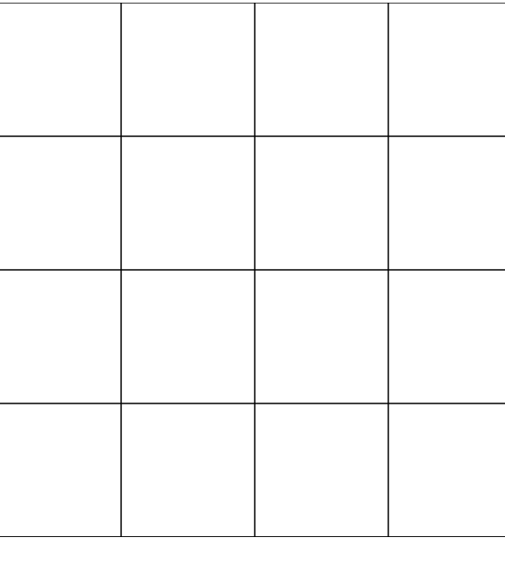
Line.html
Notes:
Rendered in the browser it looks like this:

Slide 7

The Ellipse Element
Notes:
The <ellipse> element is an SVG element used to draw an ellipse based on its center point coordinates (cx, cy) and its two radii (rx and ry).

Slide 8
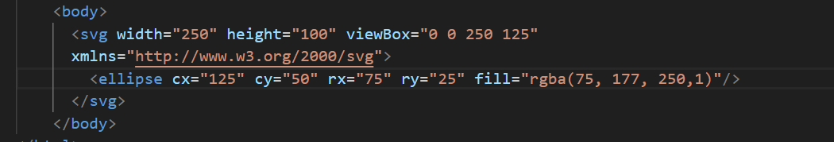
ellipse.html
Notes:
Ellipse is just like circle which we met in the first video on this series, except it takes two radius arguments, rx and ry for the x and y
radius respectively. Equivalent arguments would just draw a circle. In this case the X radius is 75 and the Y radius is 25 which makes a wide ellipse.

Slide 9
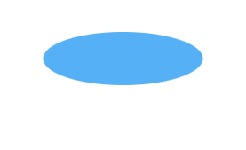
ellipse.html
Notes:
It looks like this in the browser

Slide 10

The Polygon Element
Notes:
The polygon element creates close-ended shapes consisting of multiple straight lines
starting from an initial x,y coordinate and ending with a final point on the coordinate plan.

Slide 11
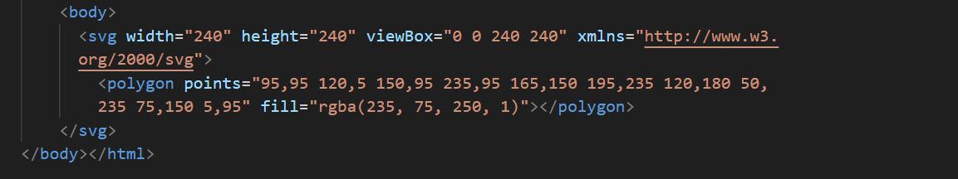
POLYGON.html
Notes:
The attribute points takes a list of points on the coordinate plan to define the polygon. The
final point of a polygon automatically connects to the first point. The following code sample
draws a star.

Slide 12

POLYGON.HTML

Slide 13
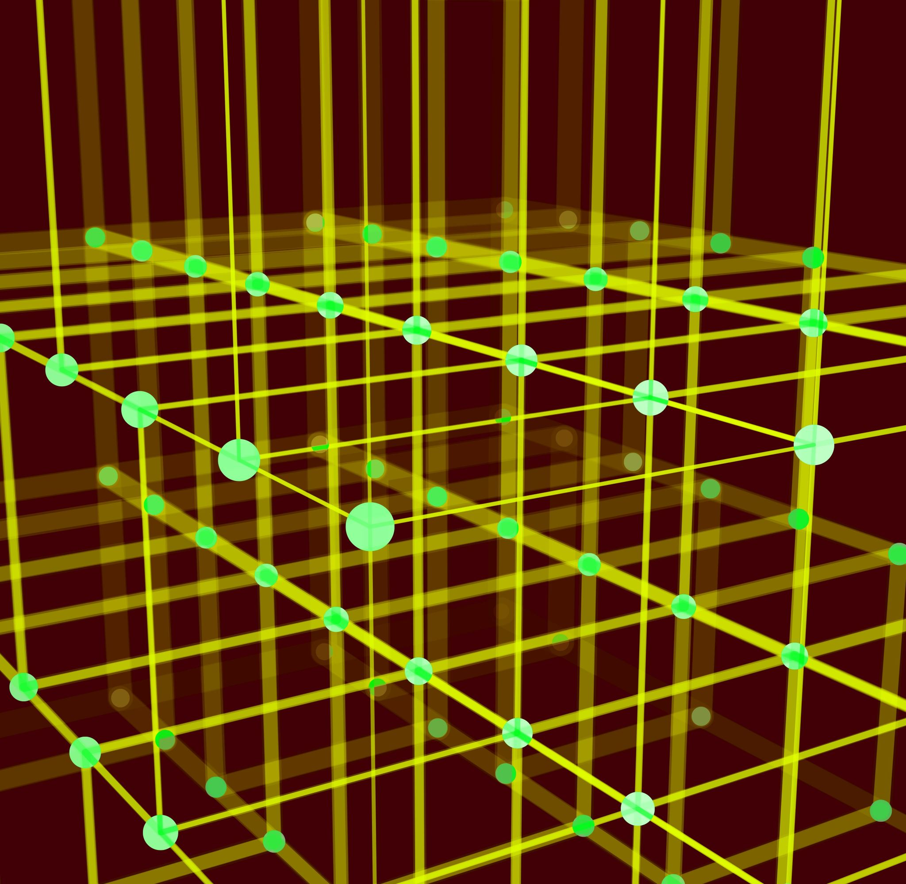
The Polyline Element
Notes:
The polyline element creates open-ended shapes consisting of multiple straight lines. The
attribute points takes a list of x,y points on the coordinate plan to define the polyline.

Slide 14
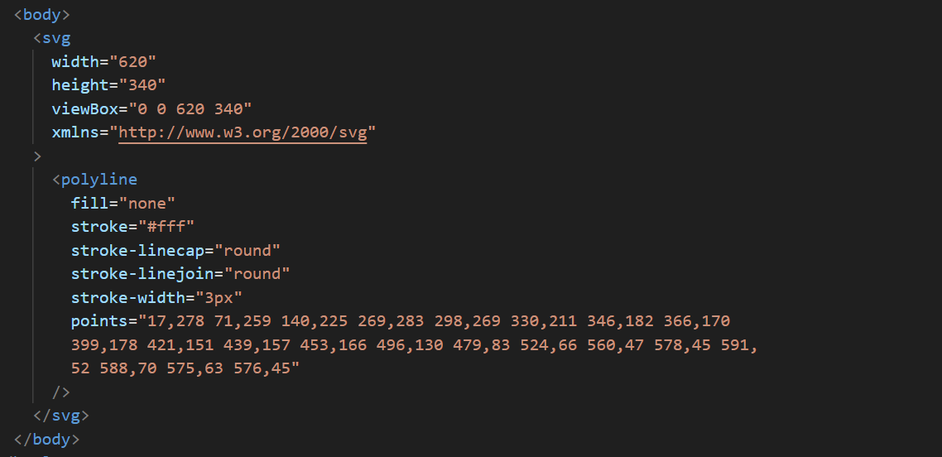
Polyline.html
Notes:
The
following code sample traces the pattern of the constellation Hydra (the sea serpent) in the night
sky.

Slide 15
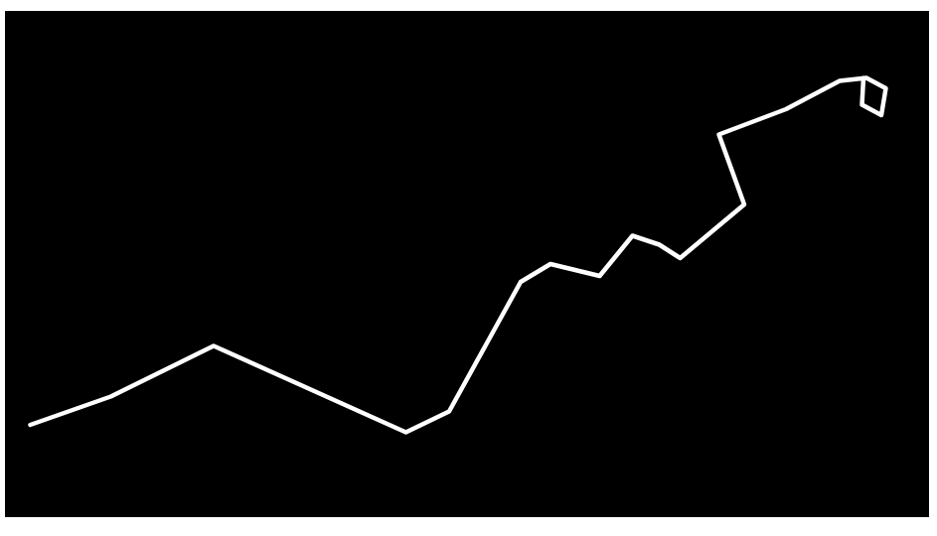
Polyline (the Constellation Hydra)

Slide 16
What we’ve learned
Key takeaways
The <line> element is an SVG element used to draw a single, straight line connecting two specified points.
The <ellipse> element is an SVG element used to draw an ellipse based on its center point coordinates (cx, cy) and its two radii (rx and ry).
The <polygon> element creates close-ended shapes consisting of multiple straight lines
The <polyline> element creates open-ended shapes consisting of multiple straight lines.

Slide 17
THANK YOU
Rob Larsen
https://htmlcssjavascript.com
https://github.com/roblarsen
https://www.linkedin.com/in/robreact/
Code and slides:
https://github.com/roblarsen/introduction-to-svg

